Slide 1

Table of Contents
RECOMMENDATION OF A LOW PERFORMING AD TO DISCONTINUE.
TEAM INTRODUCTION
EXPLANATION OF SUPERHERO U EVENT
EXPLANATION OF FACEBOOK ADS
OVERVIEW AND EXPLANATION OF CAMPAIGN
CONCLUSION

Slide 2
TEAM MEMBERS
1. Snehitha Sasanapuri(sasanapurisnehitha@gmail.com)
2. Shaik Abdul Khadar Mansoor(mansoorshaik049@gmail.com)
3. Shahid Jan Amin(shahidjanaminamin@gmail.com)
4. Shivam Sharma(shivamjsu@gmail.com)
5. Shanthini S(shanthinisaro26@gmail.com)
6. Igemhokhai Shedrach(i.v.shedrach@gmail.com)

Slide 3


Superhero U is a competition whose aim is find solutions to many of today’s challenges through Creativity and Boldness.
In this competition, participants are required to innovate a Superhero that takes on those challenges by submitting visuals that explain their superhero’s mission.

Slide 4

Superhero U competition aims to tackle the 5 P’s of Sustainable Development Goals(SDG). Hence, the Superhero created should address all these goals collectively and promote prosperity while protecting the planet, which is the competition’s theme.
Goals

Slide 5
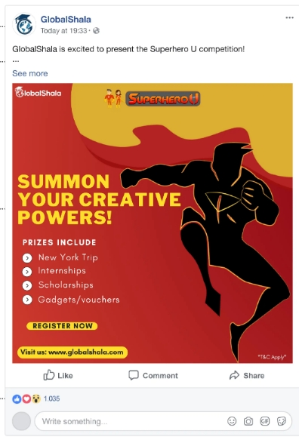
FACEBOOK ADS
A Facebook that was used by GlobalShala for Superhero u event.
Facebook ads refer to the online advertisements that are created and published on the Facebook platform to be targeted to its users.
Facebook ads are a type of display ad and can only be seen by the platform’s users who have been selected using Facebook’s targeting tools

Slide 6
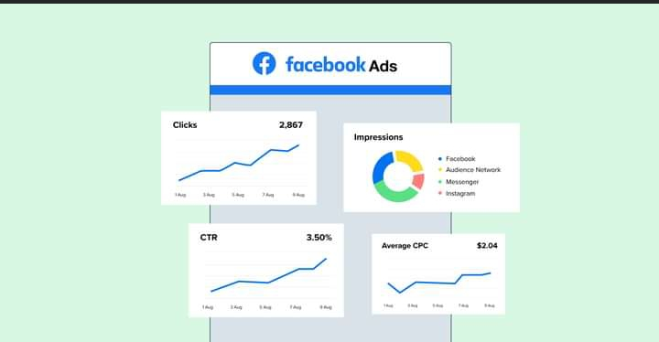
ADS METRICS
Ads Metrics are a quantifiable way to track performance and are important tools for gauging a campaign’s effectiveness.
The most appropriate marketing metrics vary greatly from one campaign to the next, but in general, they measure the effects of campaigns on audience actions.

Slide 7
ADS METRICS
Some important Facebook ads metrics are
Reach( Number of people who saw the ads at least once.)
Impression(The number of times your ad was on a viewer’s screen.)
Clicks(Total number of clicks on the Campaigns ad via links, image, reactions etc)
Unique Clicks(Total number of unique people who clicked on the ad)
Unique link click( Total number of unique people who clicked on the ad link)
Cost per Click( The average cost of one click on the ad)
Cost per Result(The average cost per unique link click on the ad)
Etc.

Slide 8
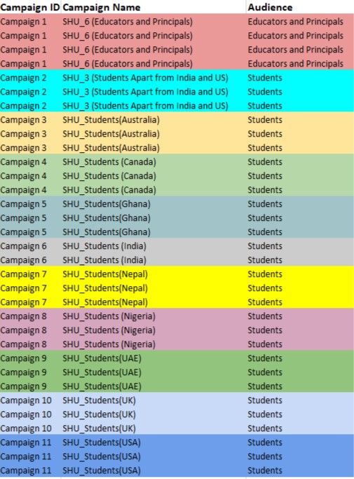
OVERVIEW OF CAMPAIGNS
For the Superhero u’s event, the ads were targeted towards certain geographical and categorical targets, called Campaigns.
The various campaigns, were classified by ID’s, where each ID depends on geography(Certain countries), and Class(Students or Educators).
The aim of this analysis, is to discontinue the campaign(s) not meeting the minimum effective target.

Slide 9
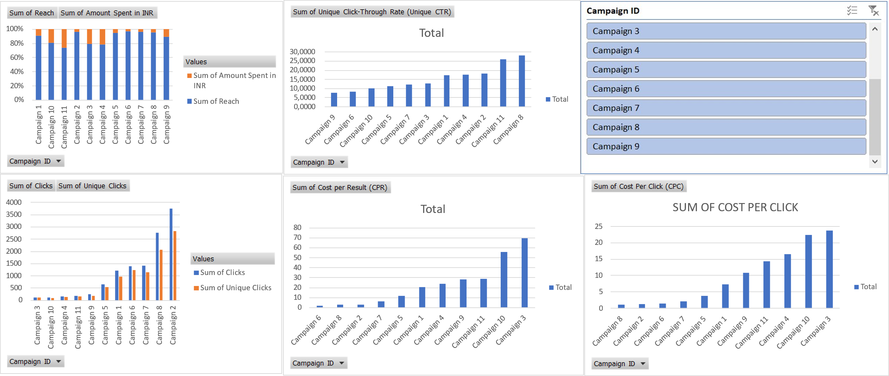
OVERVIEW OF CAMPAIGNS
For our recommendation, we’d consider the metrics that cuts across some other important metrics. Hence, we’d use the cost per click(CPC) and the Cost per Result(CPR) to make our recommendation(s). The image below is a dashboard of the some of the most important metrics against the various campaigns, made using Excel.

Slide 10
COST PER CLICK(CPC)
Ads with very high CPC are those that generated poor amount of clicks despite spending large amount in running the ad. Such ad should be discontinued and so, in this case, Campaign 3 & 10 with higher CPC are recommended.
Ineffective

Slide 11
COST PER RESULT(CPR)
Ads with very high cost per results are considered ineffective and should be discontinued for economical reasons. It entails ad that return poor results despite spending a relatively high amount in running the ad. Based on this metrics, Campaign 3 and 10 should be discontinued.
Ineffective

Slide 12
CONCLUSION
Based on the analysis in the previous slides, and the supporting visuals, the team strongly recommend that CAMPAIGN 3 and 10 be discontinued, as it appears averagely, the most underperforming ad campaigns.

